Slide 1


Slide 2
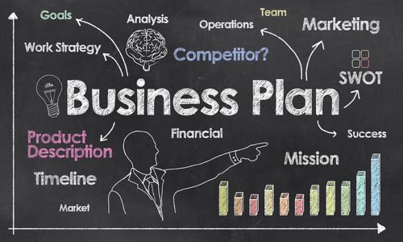
BUSINESS PLAN
Establishing foodies knot business in Brampton, Ontario part of greater toronto food help to gain customer attention (Schlegel et al. 2020)
Business is going to start with $ 130000
Operational and marketing activities used to identify potential customers
Notes:
Business plans provide information and expected outcome after establishing the business, it has been determined possibilities of profitability and risks. Business plan of a restaurant would present profitability, cash flow and possible risks of the business (Schlegel et al. 2020). Establishing foodies knot business in Brampton, Ontario part of greater toronto food help to gain customer attention and probably increase sales growth in a short time frame. This business is going to start with $ 130000 as initial investment to start this business. Operational and marketing activities used to identify potential customers and possible ways to activate new customers for sales improvisation.

Slide 3
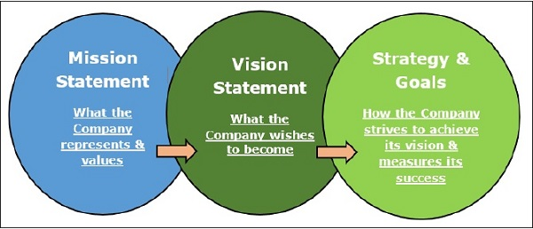
VISION AND MISSION
Extra leverage making competitive advantage (Cheah et al. 2019)
Restaurant chains along with online food delivery service
Maximum sales volume by selling food
Notes:
Mission of foodies knot is to establish healthy food restaurant chains for customers, which prefer customer satisfaction first rather than focusing on sales. Choosing the busiest place in Canada for establishing a restaurant helps to attract the attention of customers and also provide extra leverage making competitive advantage (Cheah et al. 2019). This business model focuses on restaurant chains along with online food delivery services that would cover maximum potential customers. Mission of this business is to achieve maximum sales volume by selling food to customers at an affordable price. Initial stage business plan focus on establishing complete food chain service for customers.

Slide 4
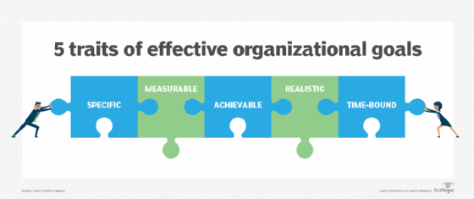
BUSINESS GOALS AND OBJECTIVES
Expand with adequate resources (Rajnoha et al. 2019)
Objectives and goals are oriented with financial development
Achieve growth of revenue around 120%
Notes:
Business goals and objectives focus on improvisation of food quality and service to customers to publish brand image. Initial stage business will be performing which one restaurant business plan will expand with adequate resources (Rajnoha et al. 2019). Objectives and goals are oriented with financial development of business plans using different business segments like online food delivery. Initial stage business goal is to achieve growth of revenue around 120% to gain sufficient amount of financial outcome. Production and cost of this organization should be under control because of managing allocated financial resources sufficient for financial productivity.

Slide 5
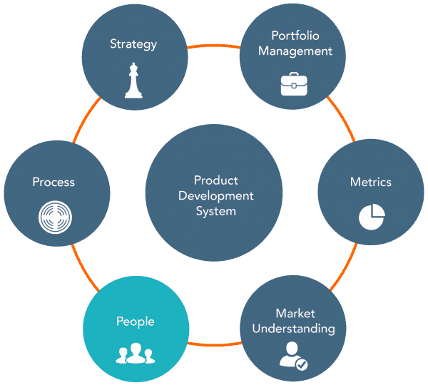
PRODUCTS OFFERED
Customer trust and meet all requirements of customers (Papageorgiou et al. 2019)
Poutine, Som tam, Tacos and Mexican Pasta as prime products
product quality would be going to target customers
Notes:
Product offered by foodies knot regarding customer expectations that is going to to achieve customer target. Revenue office organization is depending on the offered product because product quality would be going to target customers. According to the product offered by foodies knot does not explode operational activity to achieve customer trust and meet all requirements of customers (Papageorgiou et al. 2019). Product quality would be maintained by efficient employees to achieve customer trust and expectations. Products that would be offered to customers are Poutine, Som tam, Tacos and Mexican Pasta as prime products. Using delicious foods with home delivery options also creates more options to grow business revenue.

Slide 6
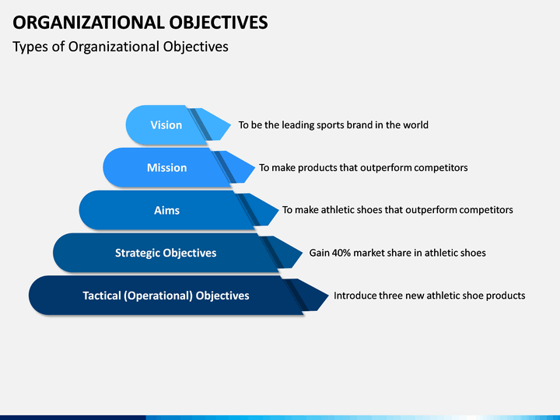
OBJECTIVES
Expected profitability through business operation (Kepczynski et al. 2018)
Total sales of this business industry has gained 36.8%
Canada is 5.19% that indicates potentiality of future growth financial year 2022
Notes:
Annual growth Trend of restaurant business in Canada is 5.19% that indicates potentiality of future growth. Financial year 2022, listed food business has gained Growth Around 7.4%, just presented potentiality of business model. overall total sales of this business industry has gained 36.8% that indicate continuous revenue growth and achieve expected profitability through business operation (Kepczynski et al. 2018). Growing profitability in this industry means an efficient amount of economical development to the country along with that equilibrium in demand and supply has been disturbed due to lack of supply chain. This business would fill up this gap between demand and supply.

Slide 7
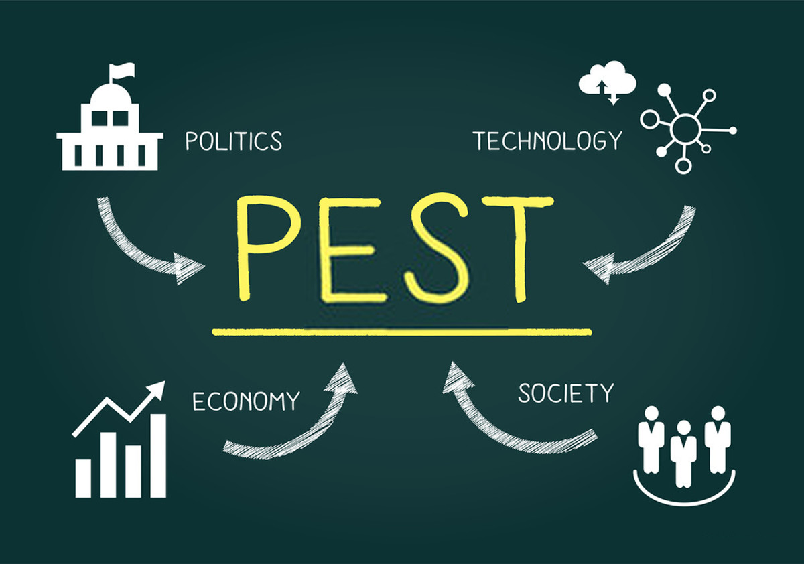
PEST analysis
Potential to achieve 30% -40% revenue
That is going to deliver effective business operations (Wei et al. 2018)
Canada has achieved US$137.90bn revenue
Notes:
PEST analysis of the food industry identification limit of the market has not been unable to be filled up by existing business organizations in a new business plan that is going to deliver effective business operations (Wei et al. 2018). Positive growth potential energy in the last few years has exploded. Business plans have the potential to achieve 30% -40% revenue. Economical growth of these businesses would be achieved by net profit 10-15%. Financial year 2022 the food industry of Canada has achieved US$137.90bn revenue that present net profitability growth around 10% to 20%. Continuous growth in this industry is going to deliver possible higher productivity in the next few years.

Slide 8
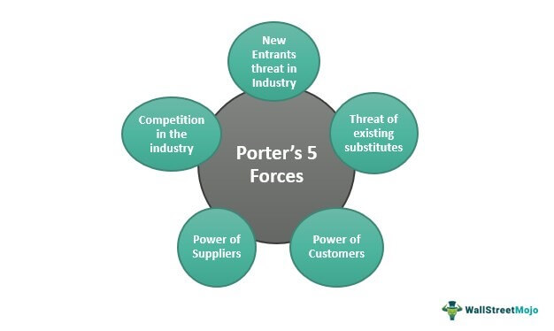
PORTER'S FIVE FORCES
Promotion of products could be possible utilization of online marketing
Establish a restaurant for customer appearance (Faccia, 2020
People are considered as customers and employees of this organization
Notes:
Product of this business plan identified different types of foods with affordable prices to gain customer attention. Promotion of products could be possible utilization of online portals and social media platforms targeting specific customer groups. Physical Evidence Business plan is going to establish a restaurant for customer appearance (Faccia, 2020). Increasing outlets in future vision operations also create business opportunities as positive growth. Processes Of the business oriented with online and outlet business models that help to improve productivity distribution of foods. People are considered as customers and employees of this organization where customers segment has been identified as a different age group. Partners Of the business operation would be suppliers and delivery partners to achieve continuous business operation.

Slide 9
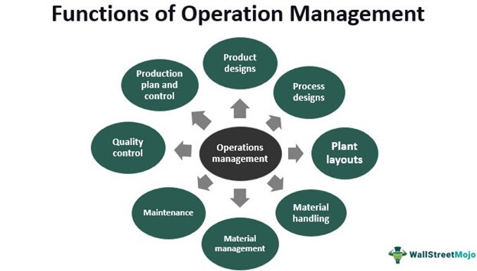
ANALYSIS OF BASIC OPERATIONS
Delivering products to customers with better experience (Gatwood et al. 2018)
Maintaining balance of resources and achieving expected output from this business
Productivity analysis and managerial process of this organization
Notes:
Operations of foodies knot is going to operate through adding new financial activities and budget planning. Additional requirement of operational activity is determined by productivity analysis and managerial process of this organization. which operation of this organization would identify suppliers of products, reading active staff and delivering products to customers with better experience (Gatwood et al. 2018). The supply chain operation of this organization is going to operate through collecting of resources from suppliers, maintaining balance of resources and achieving expected output from this business. The cost of business has been concerned $120000 Whereas remaining $10000 would be used as working capital.

Slide 10
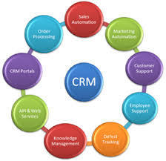
CRM APPLICATIONS
Potential customers considered in the 20 to 30 age group
Achieving a high retention rate of customers (Philips, 2019)
Gain better results receiving revenue growth
Notes:
Marketing sale of this in a business plan going to be achieved by online advertising of the restaurant. Potential customers of this business plan have been considered in the 20 to 30 age group because maximum sales could be achieved from that age segment. Customer service is going to deliver experience to customers because of achieving a high retention rate of customers (Philips, 2019). Supportive application of this business plan is going to achieve productivity and customer service to gain customer support and trust. An additional requirement of a CRM application is to gain better results receiving revenue growth.

Slide 11
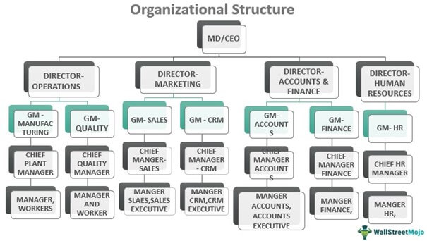
ORGANIZATIONAL STRUCTURE
Corporations to gain expected productivity (Bahit et al. 2021)
Risk management of the operational activity
Three types of managerial activities: operational, decision making and execution
Notes:
The Organizational structure of this business is going to be maintained by an open leadership approach because of achieving trust of employees. Managerial position of this organization is going to present three types of managerial activities: operational, decision making and execution. Operational managers are going to identify effective corporations to gain expected productivity (Bahit et al. 2021). Additionally decision making also provides risk management of the operational activity. Exhibition department is going to operate the whole operation with staff which is going to present better results for this business plan. Organization structure also presents a type of different operation to get it going to create balance between demand and supply.

Slide 12
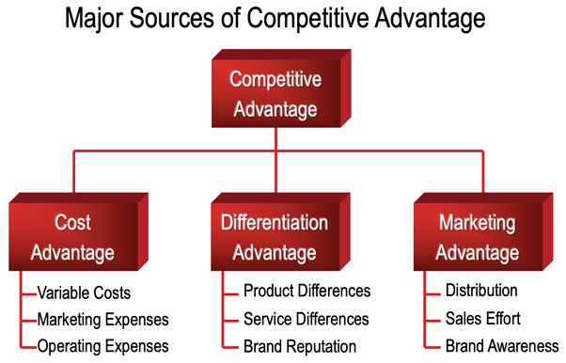
Source of competitive advantage
Identification of different prospect of Very to present legal and brand image creation regarding challenges
Objectives of the management employees revenue what are the possibilities would be implemented to reduce use of plastics
Delivering positive approach biography on new technology Very would be able to create positive image customers
Notes:
PESTLE Analysis of Very is going to explode with different aspects oriented with this organisation that also present an environmental aspect regarding use of plastic production and marketing. Fashion Retail Industry of UK adopting new technologies to avoid use of plastic and gain customer trust about environment development. Fashion organisations are also trying to establish a positive image among customers adopting new technologies regarding reuse of plastics or recycling of plastics to make fashionable products. Additional information has been conducted regarding findings of environment analysis that present the organisation and face different challenges due to excessive use of plastic.

Slide 13
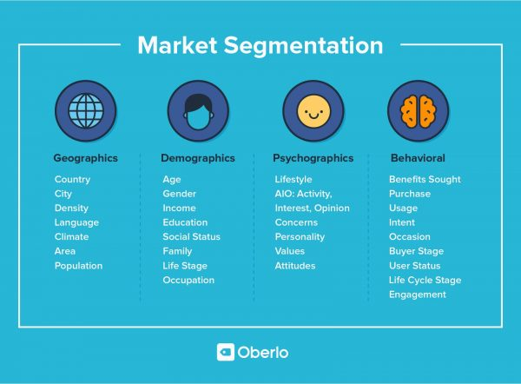
SEGMENTATION, TARGETING AND POSITIONING
Profitability rather than achieving a huge margin by future sales (Soegoto et al. 2019)
Age group consumes more than 40-50%
Profitability percentage and expected cash flow of each mont
Notes:
Segmentation of this business plan has identified less pricing of food products to make an affidavit for each customer's group. Pricing of food products would be less than 10% at market price because of this business plan targeting sales volume based profitability rather than achieving a huge margin by future sales (Soegoto et al. 2019). Targeting the age group of 20 to 30 as to gain expected revenue by business because this age group consumes more than 40-50% foods in every year of total sales. Position of the business has been identified through financial analysis that is going to present profitability percentage and expected cash flow of each month. Positioning of this business plan would b e achieved by an online advertising process.

Slide 14
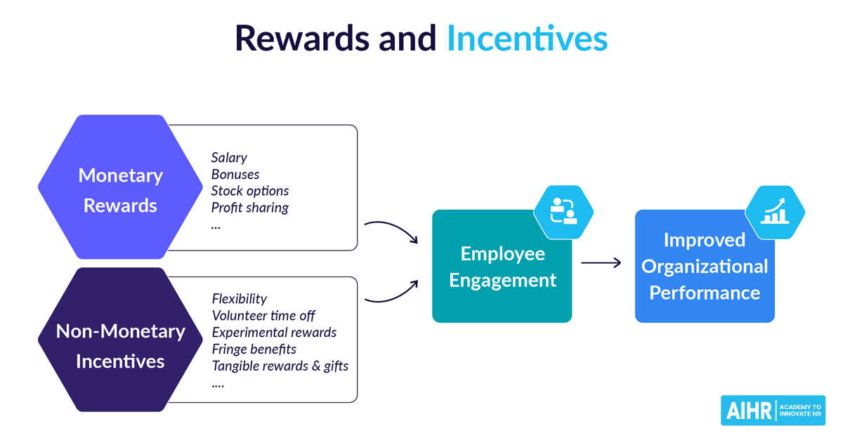
FINANCIAL AND NON-FINANCIAL BENEFITS
Customer retention rate identifies possible revenue growth
3 months financial results regarding sales and cash balance (Suriyanti, 2020)
Non financial performance identified by customer appearance
Notes:
Financial and non financial benefits of this organization As determined by forecasted financial statement. Non-financial benefits of this organization have been considered as market valuation among competitors. Also, customer retention rate identifies possible revenue growth in the next few years. Principle of this organization is going to be identified by 3 months financial results regarding sales and cash balance (Suriyanti, 2020). Targeting the age group of 20 to 30 as to gain expected revenue by business because this age group consumes more than 40-50%. Non financial performance identified by customer appearance in the restaurant frequency rate by recording weekly customer presence and change of customer presence in the next week.

Slide 15
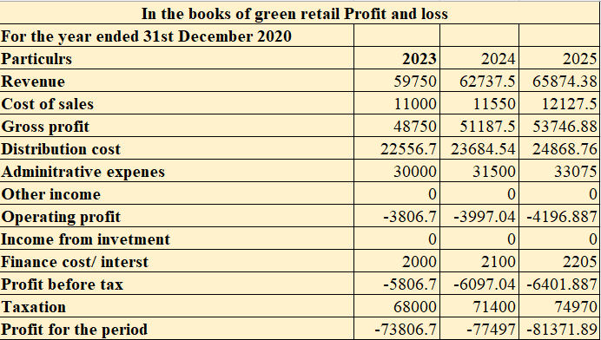
FORECASTED INCOME STATEMENT REVIEW
foodies knot has been lost in the first financial year due to lack of revenue collection
Broadcasted cash flow statements also determined politics as well as at the end of each financial month
Profitability of this business plan has identified result -73806.7 -77497.035 -81371.88675 in next three financial year
Notes:
Forecasted income statement of foodies knot has been lost in the first financial year due to lack of revenue collection. Using these financial elements, possibilities of a business plan have been identified. Second, your financial statement has reported positive growth of profitability along with revenue growth that helps to gain knowledge about potential profitability in this business plan (Mukherjee et al. 2020). Broadcasted cash flow statements also determined politics as well as at the end of each financial month in second year activity that provide knowledge of the organization of productivity has potential to gain expected profitability. Profitability of this business plan has identified result -73806.7 -77497.035 -81371.88675 in next three financial years.

Slide 16
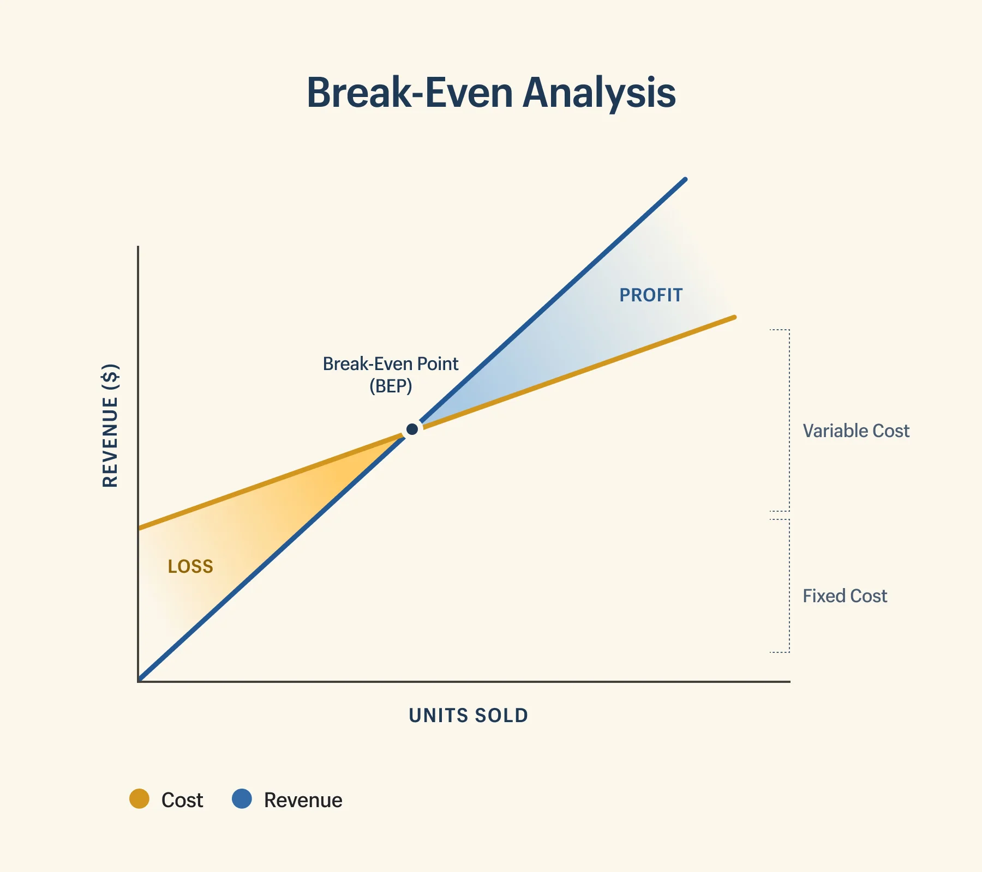
BREAK-EVEN ANALYSIS
After 6 to 7 months this business will going to achieve a positive result in profitability
Financial output to expense business (Nekhaychuk et al. 2019)
Organization has been identified 0.544 that would be use to gain more profitability in future
Notes:
Break even analysis by initial elements has presented after 6 to 7 months this business man going to achieve a positive result in profitability. In the second year this organization and profitability growth would be positive and green watch financial output to expense business (Nekhaychuk et al. 2019). Break even point of this organization has been identified 0.544 that would be use to gain more profitability in future.

Slide 17
REFERENCE LIST
Schlegel, A., Birkel, H.S. & Hartmann, E., 2020. Enabling integrated business planning through big data analytics: a case study on sales & operations planning. International Journal of Physical Distribution & Logistics Management, 51(6), pp.607-633.
Cheah, J., Amran, A. & Yahya, S., 2019. External oriented resources & social enterprises’ performance: The dominant mediating role of formal business planning. Journal of Cleaner Production, 236, p.117693.
Rajnoha, R., Lesnikova, P., Stefko, R., Schmidtova, J. & Formanek, I., 2019. Transformations in strategic business planning in the context of sustainability & business goals setting. Transformations in Business & Economics, 18(2), pp.44-66.
Papageorgiou, G., Petrakis, C., Ioannou, N. & Zagarelou, D., 2019, September. Effective business planning for sustainable urban development: the case of active mobility. In ECIE 2019 14th European Conference on Innovation & Entrepreneurship (2 vols) (p. 759). Academic Conferences & publishing limited.
Kepczynski, R., J&hyala, R., Sankaran, G. & Dimofte, A., 2018. Integrated Business Planning. Management for Professionals.
Wei, Y.L., Long, D., Li, Y.K. & Cheng, X.S., 2018. Is business planning useful for the new venture emergence? Moderated by the innovativeness of products. Chinese Management Studies.
Faccia, A., 2020. Big Data-driven Budgeting & Business Planning.
Gatwood, J., Hohmeier, K., Farr, G. & Eckel, S., 2018. A comparison of approaches to student pharmacist business planning in pharmacy practice management. American journal of pharmaceutical education, 82(5).
Philips, A., 2019. The Business Planning Tool Kit: A workbook for the primary care team. CRC Press.
Bahit, M., H&ayani, M. & Haryanto, R., 2021, July. Bibliometric Analysis on the Concept of Managing & Integrating ERP (Enterprise Resource Planning) in the MSMEs (Macro, Small & Medium Enterprises) Sector. In 2nd Annual Management, Business & Economic Conference (AMBEC 2020) (pp. 5-9). Atlantis Press.
Armstrong, A., Brown, L., Davies, G., Whyatt, J.D. & Potts, S.G., 2021. Honeybee pollination benefits could inform solar park business cases, planning decisions & environmental sustainability targets. Biological Conservation, 263, p.109332.
Soegoto, E.S., Fauzi, S.I. & Valentina, T., 2019, December. Relationship between enterprise architectures planning & information system. In Journal of Physics: Conference Series (Vol. 1402, No. 6, p. 066078). IOP Publishing.
Suriyanti, S., 2020. Planning strategy of operation business & maintenance by analytical hierarchy process & strength, weakness, opportunity, & threat integration for energy sustainability. 670216917.
Mukherjee, M., Chatterjee, R., Khanna, B.K., Dhillon, P.P.S., Kumar, A., Bajwa, S., Prakash, A. & Shaw, R., 2020. Ecosystem-centric business continuity planning (eco-centric BCP): A post COVID19 new normal. Progress in Disaster Science, 7, p.100117.
Nekhaychuk, D., Nogas, I., Nekhaychuk, E. & Dzhelilov, A., 2019, June. The financial planning & its tasks in modern models of enterprise management. In Volgograd State University International Scientific Conference" Competitive, Sustainable & Safe Development of the Regional Economy"(CSSDRE 2019) (pp. 38-41). Atlantis Press.

Slide 18


